Slide 1
MySQL, PostgreSQL and SQL SERVER .
The presentation of the 3 relational DBMS:

Slide 2
What is a RDBMS (Relational Database Management System)?
A relational database management system (RDBMS) is a collection of programs and capabilities that enable IT teams and others to create, update, administer and otherwise interact with a relational database. RDBMSes store data in the form of tables, with most commercial relational database management systems using Structured Query Language (SQL) to access the database. However, since SQL was invented after the initial development of the relational model, it is not necessary for RDBMS use.

Slide 3
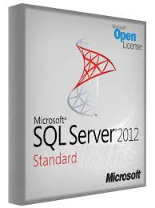
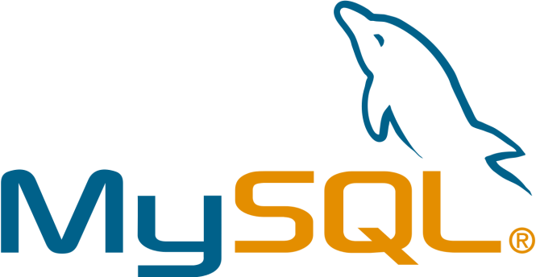
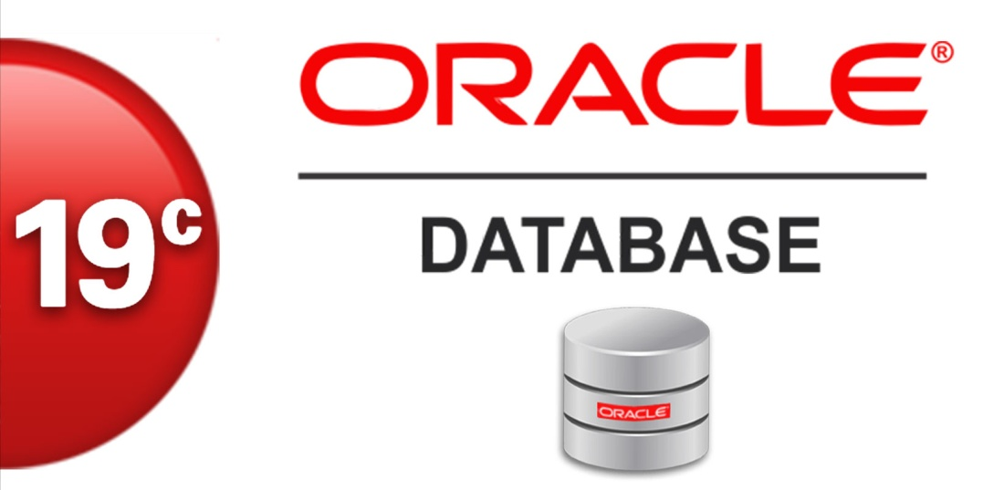
*The most commonly used relational database management systems include:

Slide 4
the most 3 well known relational RDBMS :
-MYSQL
-PostgreSQL
-SQL SERVER

Slide 5
What’s my SQL
MySQL Database Service est un service de base de données entièrement géré pour déployer des applications natives du cloud en utilisant la base de données open source la plus populaire au monde. Ce service est développé, géré et supporté à 100% par l'équipe de MySQL.

Slide 6
What’s PostgreSQL
PostgreSQL is a powerful, open source object-relational database system that uses and extends the SQL language combined with many features that safely store and scale the most complicated data workloads. The origins of PostgreSQL date back to 1986 as part of the POSTGRES project at the University of California at Berkeley and has more than 30 years of active development on the core platform.
PostgreSQL has earned a strong reputation for its proven architecture, reliability, data integrity, robust feature set, extensibility, and the dedication of the open source community behind the software to consistently deliver performant and innovative solutions. PostgreSQL runs on all major operating systems, has been ACID-compliant since 2001, and has powerful add-ons such as the popular PostGIS geospatial database extender. It is no surprise that PostgreSQL has become the open source relational database of choice for many people and organisations.
Getting started with using PostgreSQL has never been easier - pick a project you want to build, and let PostgreSQL safely and robustly store your data.

Slide 7
What’s SQL SERVER ?
SQL Server is a relational database management system, or RDBMS, developed and marketed by Microsoft.
Similar to other RDBMS software, SQL Server is built on top of SQL, a standard programming language for interacting with the relational databases. SQL server is tied to Transact-SQL, or T-SQL, the Microsoft’s implementation of SQL that adds a set of proprietary programming constructs.
SQL Server works exclusively on Windows environment for more than 20 years. In 2016, Microsoft made it available on Linux. SQL Server 2017 became generally available in October 2016 that ran on both Windows and Linux.

Slide 8
Comparaison of the 3 RDBMS
Both PostgreSQL and MySQL are time-proven solutions that can compete with enterprise solutions such as Oracle and SQL Server. MySQL has been famous for its ease of use and speed, while PostgreSQL has many more advanced features, which is the reason that PostgreSQL is often described as an open-source version of Oracle.
PostgreSQL et MySQL sont des solutions éprouvées pouvant rivaliser avec des solutions d'entreprise telles que Oracle et SQL Server.

